Slide 1
Automated Data Validation and Reporting Framework
For Snowflake Pipelines
CSL7510 VCC COURSE PROJECT
Contributors:
- Prem Oswal (M23AID037)
- Chirag Chinmay (M23AID005)
- Pritish Tripathy (M23AID055)
- Doyel Saha (M23AID040)

Slide 2
Project Overview
A lightweight, Python-based validation framework designed for Snowflake pipelines.
Key Features:
- Count Checks
- Data-level Comparisons
- CI/CD Integration
Outputs:
- Detailed PDF Reports
- Matched vs. Mismatched Records
- Validation Summary

Slide 3
Problem
Manual validation is error-prone and inefficient.
No out-of-the-box validation in Snowflake.
Lack of automated reporting.
CI/CD testing gap.

Slide 4
Challenges Identified
1. Manual SQL scripts are tedious and error-prone
2. No structured output or centralized reports
3. Frequent pipeline runs make manual validation impractical
4. Snowflake lacks built-in data validation tools
5. Lack of CI/CD compatibility

Slide 5
Our Solution
A scalable, automated solution with audit-ready reports and seamless integration.
Establishes a secure connection to Snowflake using Snowpark and connection credentials from
connection.json.
Reads validation instructions from a centralized metadata table (TEST_SCRIPTS).
Executes validation logic (count checks and data comparisons).
Generates structured PDF reports summarizing validation results.
Uploads the results to specific Snowflake stages.

Slide 6
Technology Stack
Component | Technology Used
----------------|------------------------
Data Platform | Snowflake
Compute Layer | Snowpark (Python)
Language | Python 3.x
Reporting | ReportLab
IDE | VS Code
Deployment | Manual/CLI (CI/CD)

Slide 7
Implementation Flow
1. Upload test cases in TEST_SCRIPTS (active_flag = 'Y')
2. Run main.py from terminal
3. Connects to Snowflake using connection.json
4. Executes count and data-level validations
5. Saves results in Snowflake stages
6. Generates PDF reports

Slide 8
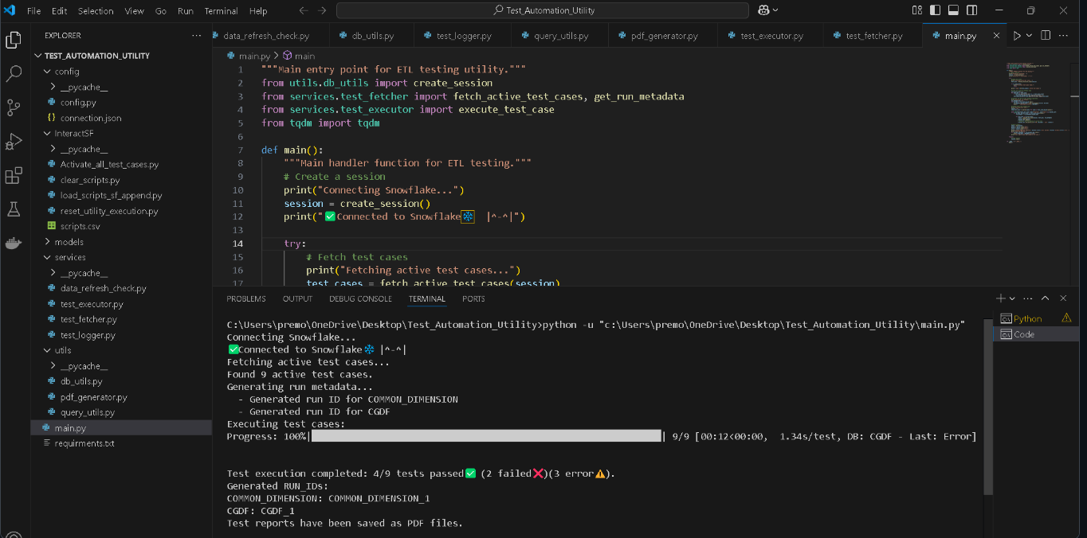

Slide 9
Validation Types
1. Count Validation:
- Compares row counts between staging and target tables
2. Data-Level Validation:
- Compares record-level values
- Identifies:
- Missing records
- Mismatches
- Type differences

Slide 10
Reporting Module
PDF Report Features:
- Color-coded PASS/FAIL summary
- Count and data comparison
- Timestamped audit log
- Stored in Snowflake TEST_RESULTS & MISMATCH_RESULTS
Library Used: ReportLab

Slide 11
Results
Successfully validated across multiple environments
Integrated with Git-based CI/CD
Reduced manual effort by over 70%
Clean, audit-friendly PDF summaries

Slide 12
Conclusion
Modular, extensible, and low-cost
Open-source and easy to adopt
Enhances QA cycle efficiency
Enables consistent, repeatable testing
Ideal for: QA Teams, Data Engineers, Academic Research

Slide 13
Future Scope
1. UI Dashboard (Streamlit/Dash)
2. Multi-warehouse support (BigQuery, Redshift)
3. Historical validation trends
4. Email/Slack alerts
5. AI/ML for anomaly detection
6. Real-time & streaming validations
7. RBAC-based access control

